Slide 1
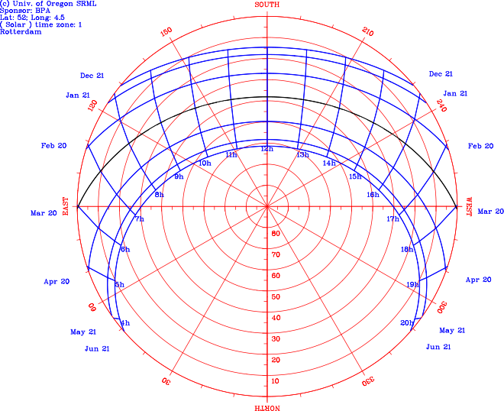
FINDING SUN'S PATH

Slide 2
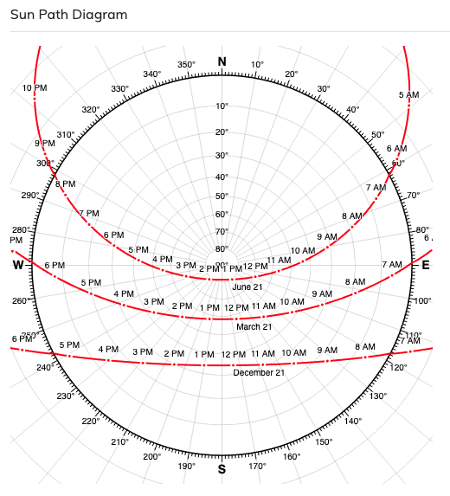

Slide 3
Hight of the sun in the sky
(altitude)
The hight of the sun refers ot the angle of the Sun relative to the Earth's horizon. As it is an agle we count it in degrees ( °).
The angle is 0° during dust and suring its dawn it can reach up to 90° (zenith) at midday, im places near the equator.
Due to inclination of the Earth's axis of rotation the position of the sun in the sky in the equator at midday defers during the year by +/- 23.5 degrees from the zenith.

Slide 4
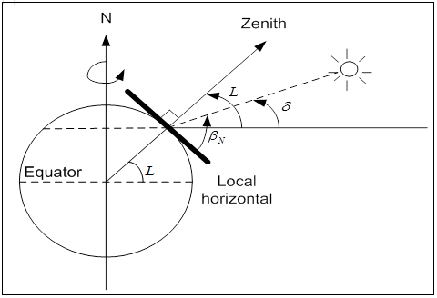

Slide 5
Angle of Azimuth
It is the direction of a celestial object from the observer, expressed as the angular distance from the north or south point of the horizon to the point at which a vertical circle passing through the object intersects the horizon.
(the horizontal angle or direction of a compass bearing)
Usually we start counting from the North (0° / 360°) towards East.

Slide 6
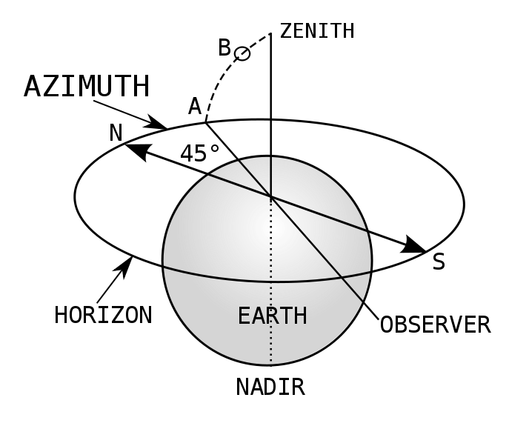
Or we can define the azimuth according to the hemisphere.
For locations in the north hemisphere zero azimuth refers to the South, positive angles refer to the direction of West and negative angles refer to East direction.

Slide 7
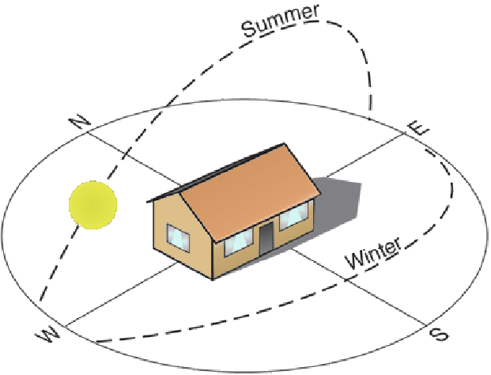
Athina Maria Athanasaki

Slide 8
Sources
Motions of the Sun simulator
Sun Path (wikipedia)
Position of the Sun (wikipedia)
Solar altitude
Solar Zenith Angle (wikipedia)
Solar Azimuth (wikipedia)
Diagram of Sun's path

